Slide 2
Objectives
Understand and use library routines including:
MOD
DIV
ROUND
RANDOM

Slide 3
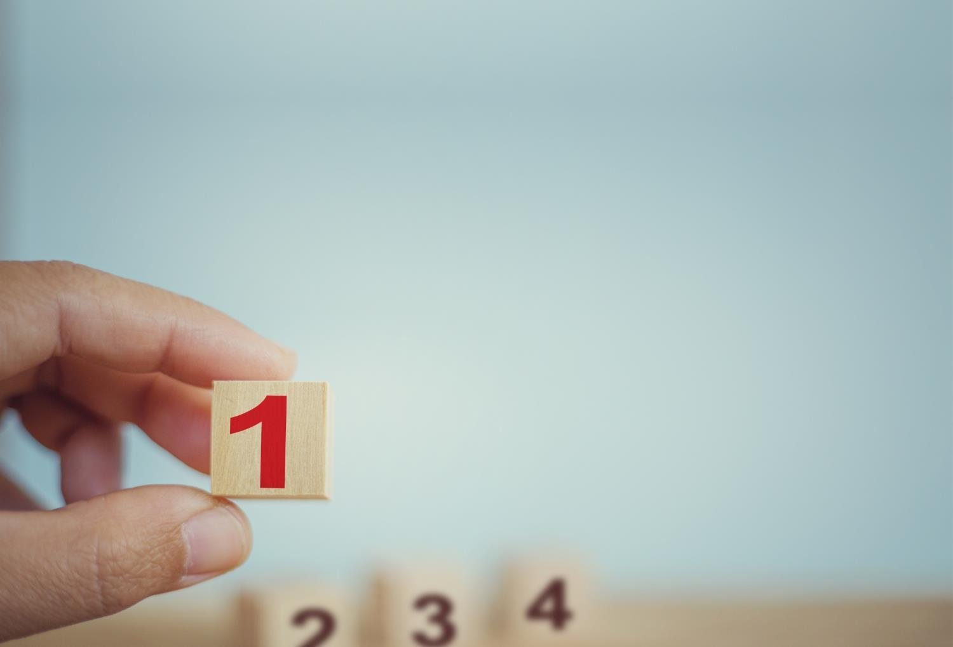

Starter
What is an algorithm for finding the minimum number from an array of numbers?
Why don’t programmers need to program this algorithm every time they need to find the minimum?

Slide 4
Minimum algorithm
Minimum algorithm:
Numbers ← [5,2,6,9] min ← numbers[0] FOR i ← 1 TO LENGTH(Numbers) IF Numbers[i] < min THEN min ← numbers[i] OUTPUT min
Programmers don’t need to re-invent the wheel every time
They make use of library routines which have already been written

Slide 5
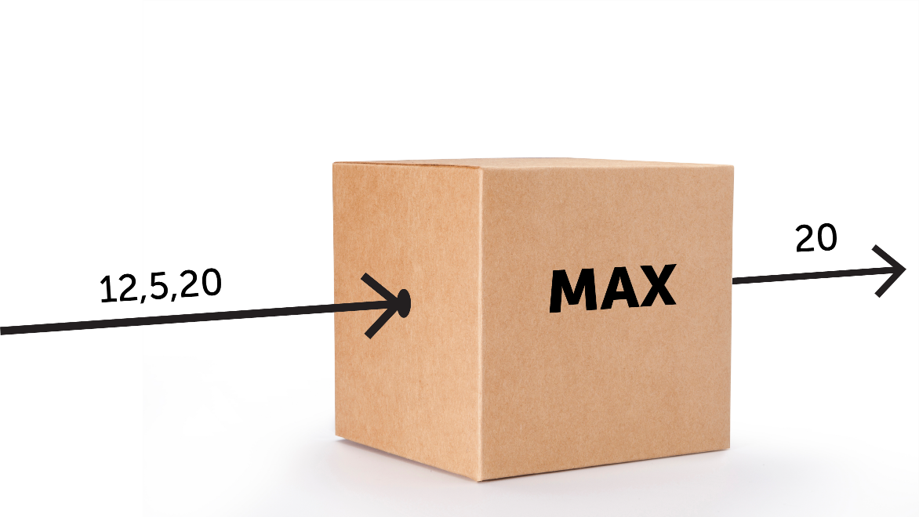
Library routines
Library routines are algorithms which programmers have made
They can be reused by other programmers
You don’t need to know how the algorithms work in order to use them – they are like a box that takes inputs and gives outputs, but what happens inside is not important

Slide 6
Rounding numbers
The ROUND function will round a number to the number of decimal places given as <places>
ROUND(<identifier>, <places>)
ROUND(5.287, 2) returns 5.29
What is the pseudocode to carry out the following?
Round 18.7356 to one decimal place
Round a variable Distance (in metres) to the nearest cm
Round the variable Age to the nearest whole year

Slide 7
Rounding numbers
What is the pseudocode to carry out the following?
Round 18.7356 to one decimal place
ROUND(18.7356, 1)
Round a variable Distance (in metres) to the nearest cm
ROUND(Distance, 2)
Round the variable Age to the nearest whole year
ROUND(Age, 0)

Slide 8
Worksheet 5
Now complete Task 1 on Worksheet 5

Slide 9
Random numbers
A random number between 0 and 1 is generated with the following pseudocode:
RANDOM()
This returns a number such as 0.13984
A random number between 0 and 100 can then be generated with a statement such as
RANDOM() * 100
How could you create a random integer between 0 and 100?

Slide 10
Random numbers
How could you create a random integer between 0 and 100?
ROUND(RANDOM() * 100, 0)
Whilst this will generate random integers between 0 and 100, there will not be as many 0 or 100 integers generated
This is because only 0.0-0.49 will generate a 0 and only 99.5 to 100.0 will generate a 100
A better way to generate a random integer would be:
ROUND((RANDOM() * 100) + 0.5, 0)

Slide 11
Random numbers
Many languages require a library to be imported before the routines can be used
For example, in Python, import random will import the random library of functions
A random number between 0 and 100 can then be generated with a statement such as
random.randint(0, 100)
How could you simulate the throw of a dice?

Slide 12
Random numbers
How could you simulate the throw of a dice?
Pseudocode:
INPUT Die Dice ← ROUND((RANDOM()*6)+0.5,0) OUTPUT Dice
Python:
import random dice = random.randint(0, 6) print(dice)

Slide 13
Worksheet 5
Now complete Task 2 Worksheet 5

Slide 14
MOD and DIV
Some languages will use MOD and DIV as library routines
For instance MOD(5,2) returns 1 DIV(7,3) returns 2
In IGCSE pseudocode the MOD and DIV operators are used:
5 MOD 2 evaluates to 1 7 DIV 3 evaluates to 2
Python: 5 % 2 evaluates to 1 7 // 3 evaluates 2

Slide 15
Standard methods of solution
In IGCSE you are expected to cover a number of standard methods of solution such as:
Searching (linear)
Sorting (bubble sort)
Totalling
Counting
Maximum, minimum and average
Library routines are also available to save programming these from scratch

Slide 16
Python library routines
The following Python library routines are available:
Routine | Example | Output
Maximum | max([5,2,8]) | 8
Minimum | min([5,2,8]) | 2
Sum | sum([5,2,8]) | 15
(Mean) average | import statistics statistics.mean([5,2,8]) | 5
Sort an array | animals = ['rabbit', 'cat', 'dog', 'hamster'] animals.sort() | ['cat', 'dog', 'hamster', 'rabbit']
Search an array | 'hamster' in Animals | True

Slide 17
Python library routines
Explain what the following algorithm does:
import statistics ages = [18,2,14,6] a = min(Ages) b = max(Ages) c = sum(Ages) d = statistics.mean(ages) ages.sort() print(ages) print(a,b,c,d) if 14 in ages: print("14 present")

Slide 18
Python library routines
Explain what the following algorithm does:
import statistics ages = [18,2,14,6] a = min(Ages) b = max(Ages) c = sum(Ages) d = statistics.mean(ages) ages.sort() print(ages) [2, 6, 14, 18] print(a,b,c,d) 2 18 40 10 if 14 in ages: print("14 present") 14 present

Slide 19
Worksheet 5
Now complete Task 3 Worksheet 5

Slide 20


Plenary
What is the result of the following library routines that are written in pseudocode?
ROUND(2.5126,3) RANDOM() ROUND((RANDOM()+0.5)*10,0)
What would the pseudocode be to convert a REAL number stored in totalBill to two decimal places?

Slide 21
Plenary
What is the result of the following library routines that are written in pseudocode?
ROUND(2.5126,3) 2.513 RANDOM() A random number between 0 and 1 ROUND((RANDOM()+0.5)*10,0) A random integer between 1 and 10
What would the pseudocode be to convert the floating point number stored in totalBill to two decimal places?
ROUND(totalBill, 2)

